Slide 1
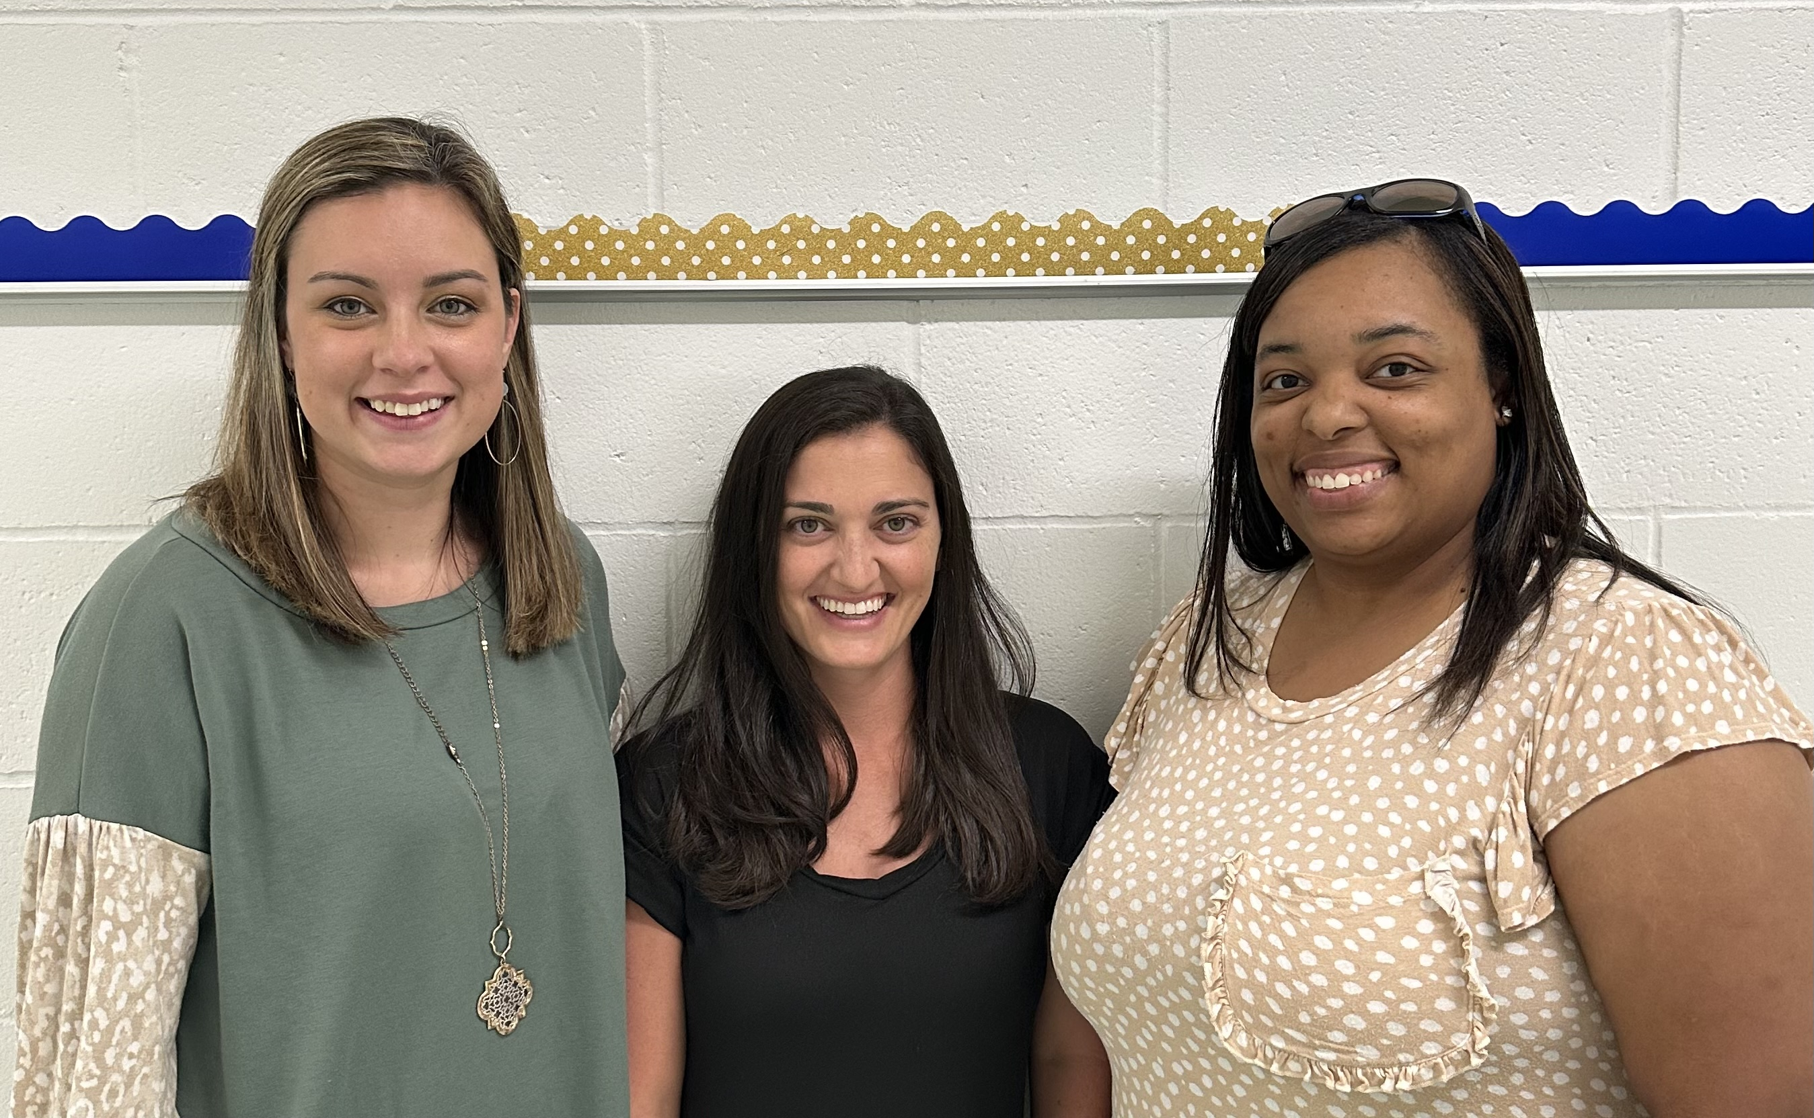
MEET THE TEAM!
Mrs. Gross, Mrs. Hoard and Mrs. Mangum
(601)932-7981
Break: 7:40-8:20
We also check planners daily!
Pictured left to right:
Mrs. Gross (Science), Mrs. Mangum (Language Arts and Social Studies), and Mrs. Hoard (Math)
We are so excited to have you in our class this year! This will be the best year!
trbrown@pearlk12.com
Family: John Michael (husband)
Pets: 0
Schools: McLaurin Attendance Center c/o 2008, Southern Miss
Food: Japanese
Movie: “Love & Basketball”
Animal: Dog
Color: Purple
Drink: Sprite
Season: Summer
Teams: Pearl Pirates & LSU Tigers
Fast Food: Chick-Fil-A
Hobby: Traveling
Store: Target and Amazon
Fun Fact: I am an LSU fan, and my husband is an Auburn fan. When football season begins it get very interesting and normally, I run everyone to the other side of the house.
kgross@pearlk12.com
Family: Robby(husband)
Pets: 2 dogs, 12 turtles, 1 goat, 1 bearded dragon, chickens, fish
Schools: PHS c/o 2016, MC (twice)
Food: Mexican, Japanese
Movie: “Beauty and the Beast”
Animal: Dogs
Color: Blue
Drink: Strawberry Lemonade
Season: Summer
Teams: Pearl Pirates & LSU Tigers
Fast Food: Chicken Salad Chick
Hobby: going to look at reptiles and to zoos
Store: Target/Amazon
Fun Fact: I am an LSU fan and my husband is an Alabama fan. Holidays and family get togethers are very interesting.
hmangum@pearlk12.com
Family: Marcus (husband), Linden (4), Nellie Kate (1)
Pets: 0
Schools: PHS c/o 2007, Ole Miss, Belhaven, & MC
Food: Japanese
Movie: “Sing 2”
Animal: Dog
Color: Lime Green
Drink: Dr. Pepper
Season: Summer
Teams: Pearl Pirates & Ole Miss Rebels
Fast Food: Chick-Fil-A
Hobby: Traveling
Store: Target
Fun Fact: I love the beach. I lived there during the summers when I was in college.
MRS. HOARD
MRS. GROSS
MRS. MANGUM

