Slide 1


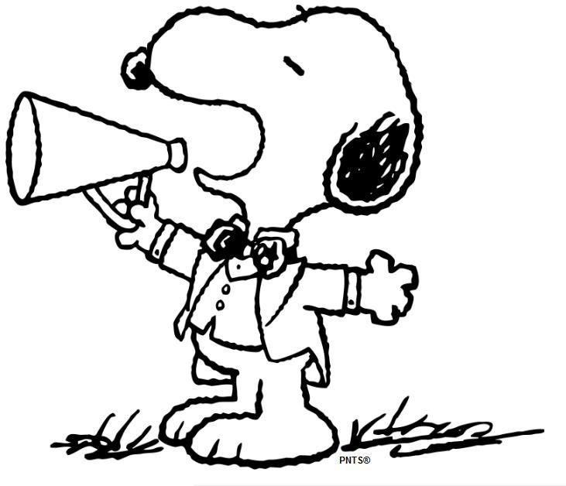
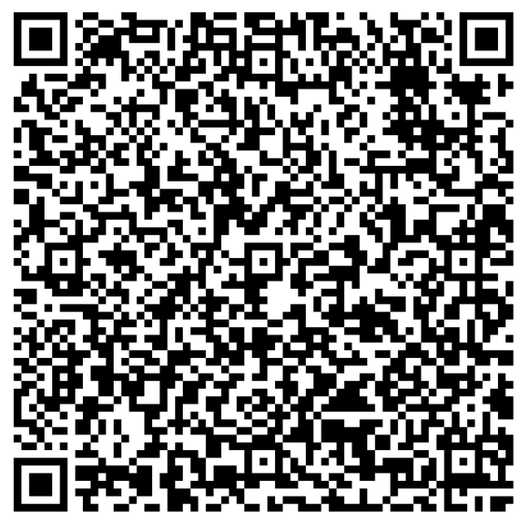
MRS.KING’S
WEEK OF: FEBRUARY 5-9, 2024
WE ARE LEARNING
Coming up @ NSE
Weekly Skills
WORDS TO KNOW
ELA: Poetry
PHONICS: OU, OW
MATH: Adding/Subtracting two 3- digit numbers
LANGUAGE: Adverbs
Social Studies: Famous Americans
2/8- Progress Reports
2/9- Valentine’s Party
VOCABULARY
**vocab test will be 2/9**
1.) Caption- it describes what is happening in the picture
2.) Image- a picture
3.) Similar- almost the same as something else
4.) Main Idea- what the passage is mostly about
5.) Glossary- it provides the meaning of key words
PHONICS Skill OF THE WEEK
Spelling Words – OU, OW
bounce
snout
trout
mouth
pouch
hound
mount
sprout
clouds
read
live
count
shout
grouch
loud
ground
house
pretty
couch
mouse
IMPORTANT DATES
YEARBOOKS ARE ON SALE
THROUGH FEB. 29TH!
SPRING MUSIC PROGRAM
Our music program is April 4th! Sign & return your slip if you want your child to participate! ☺
Reminders-
Send Snack/Water. Spelling/Vocab. Test Friday!

